Slide 1
Web Based 2D Game
BY RISHABH NEGI
SEC-B
Roll no-24
Univ. Roll no-1918910

Slide 2

Ping-Pong Web Based 2D Game
A game for Entertainment
In this Mini-Project I have Created a website about has a Home page and a GAME PAGE, the first page consists information about myself , my hobbies and interests , this page also include a Game page Link which leads to another page that is my game page, There I have created a very simple and easily palayable game which among the the peers is usually known as “ping-pong game” ,
This is my first website so I have tried to keep it simple , the web technologies used in this project are HTML , CSS , JS.

Slide 3
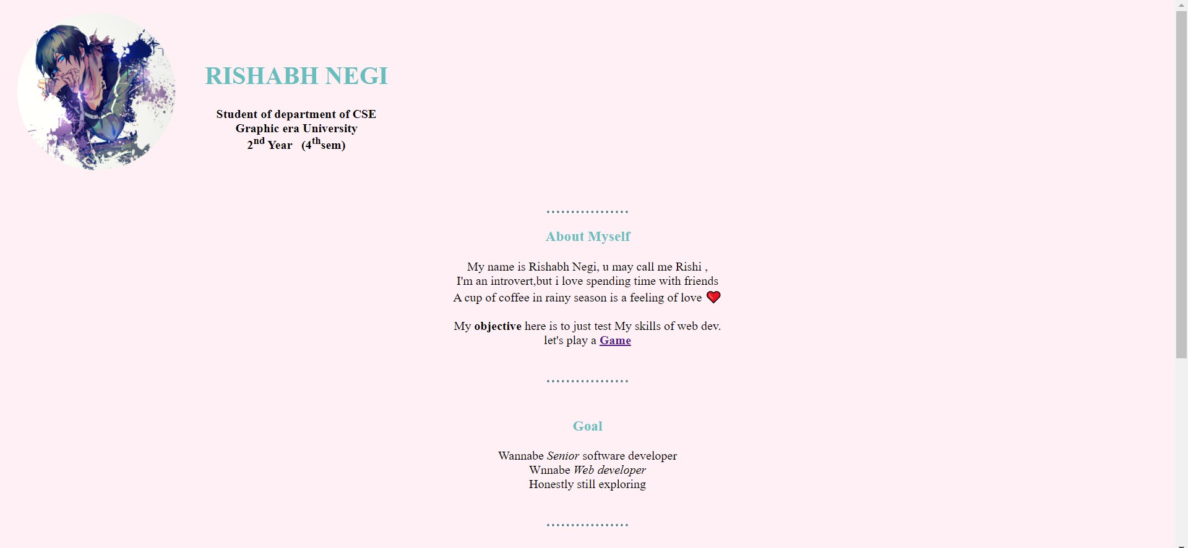
HOME PAGE

Slide 4
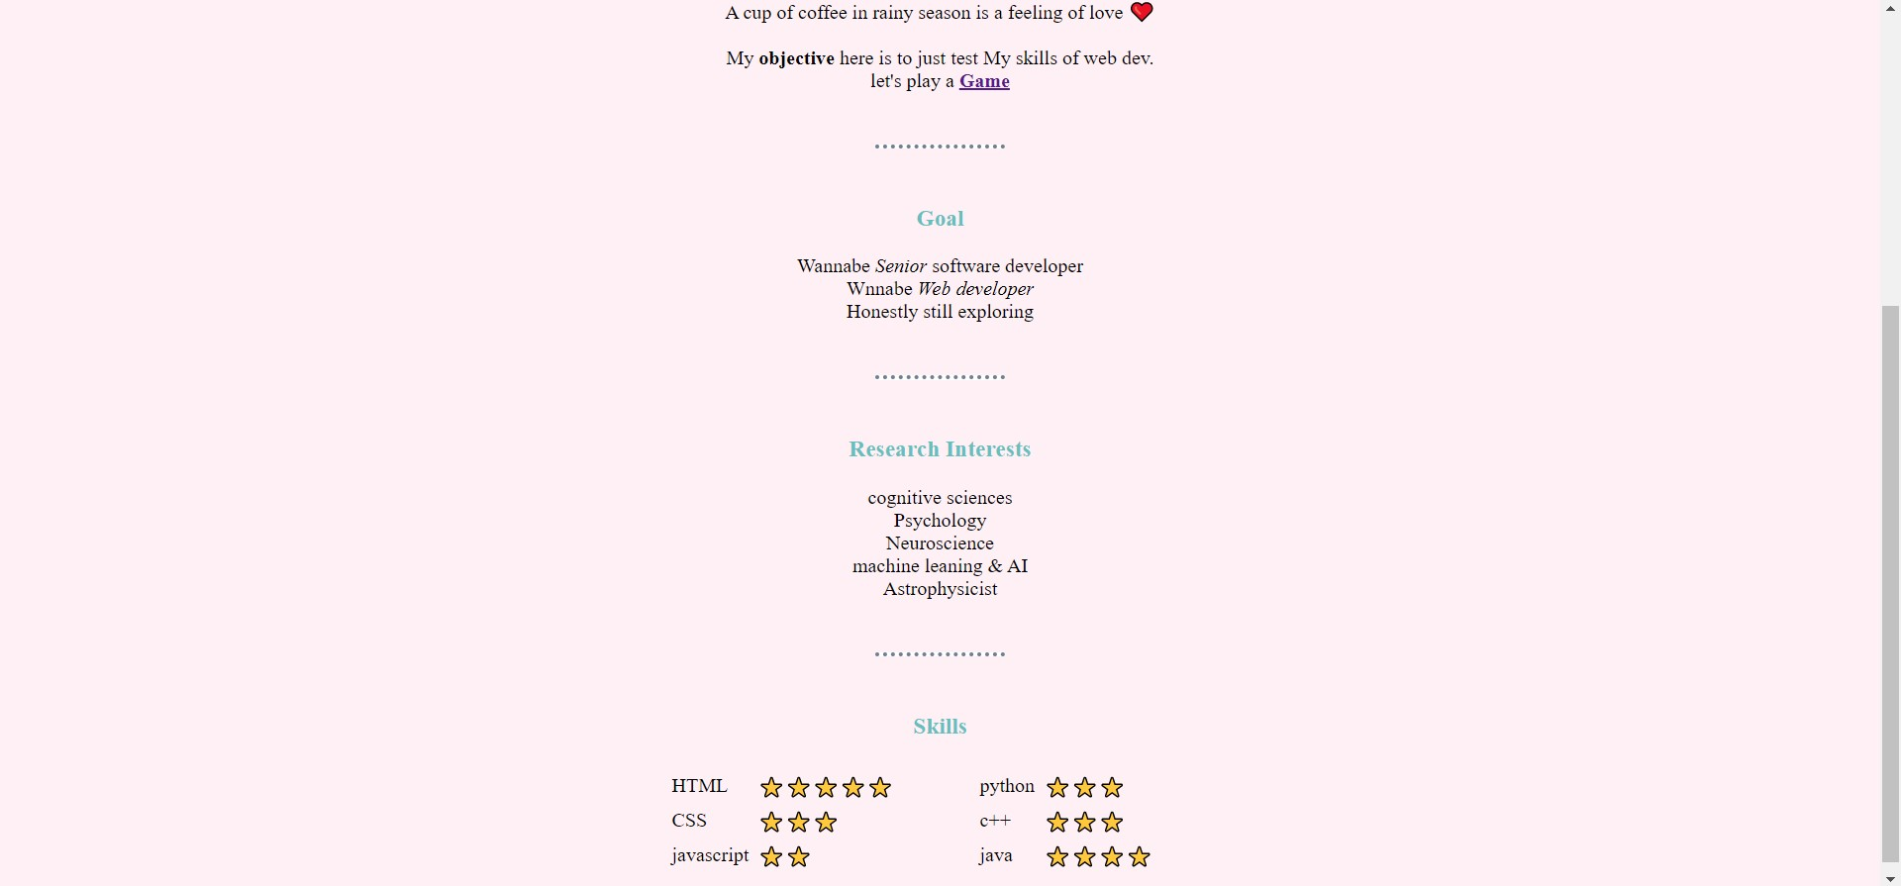
CONTINUE…..

Slide 5
Imp. Html code
<body>
<h1><strong>Ping Pong Game</strong></h1>
//Adding canvas element to add animations in my code
<canvas id="pong" width="600" height="400"></canvas>
//adding jscript file in html code
<script src=“ping_pong.js"></script>
</body>

Slide 6
Game Modules:
Creating Paddle objectS
Creating A Net within the camvas
Creating ball object
Creating Score Functions
RENDER THE GAME
CoLLISION DETECTION
UPDATE SCORES

Slide 7
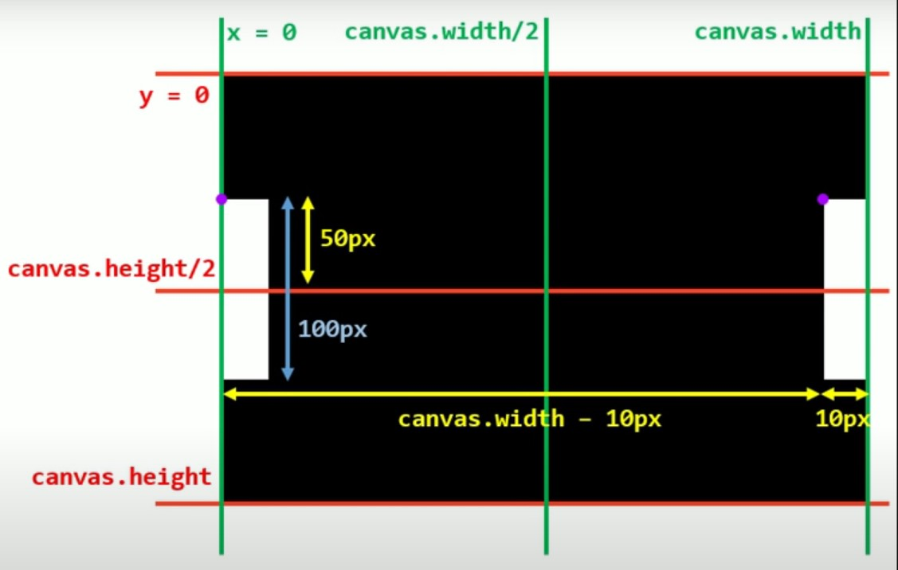
Creating Paddle Object
// User Paddle
const user = {
x : 0,
y : (canvas.height - 100)/2,
width : 10,
height : 100,
score : 0,
color : "WHITE"
}
// COM Paddle
const com = {
x : canvas.width - 10,
y : (canvas.height 100)/2,
width : 10,
height : 100,
score : 0,
color : "WHITE"
}

Slide 8
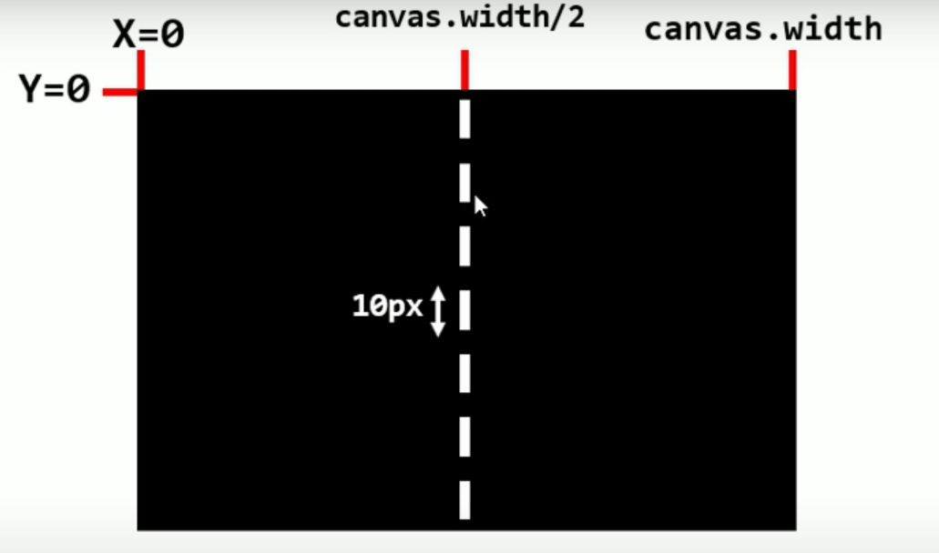
Creating a NET
// creating NET object
const net { {
x : (canvas.width - 2)/2,
y : 0,
height : 10,
width : 2,
color : "WHITE"
}}
// move the net using loop
//incrementing 15 each time , 0 as its intial y, after i=0, it gets y+15, 5 as gap between the individual net rect
function drawNet(){{
for(let i = 0; i <= canvas.height; i+=15){{
drawRect(net.x, net.y + i, net.width, net.height, net.color);
}
}

Slide 9
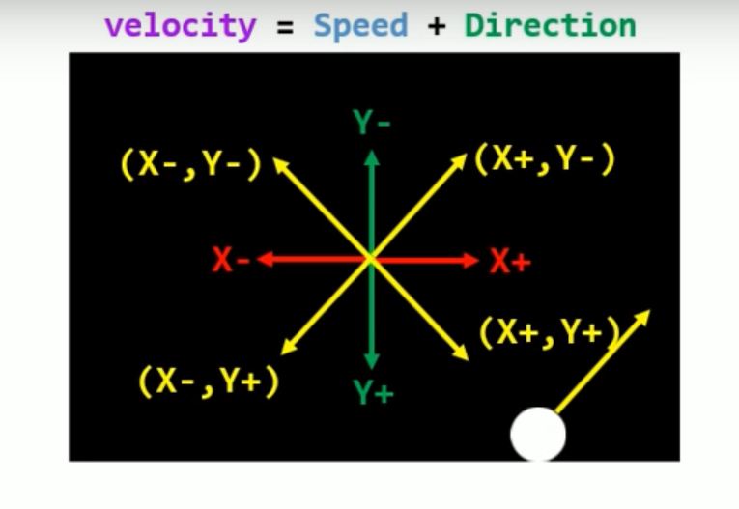
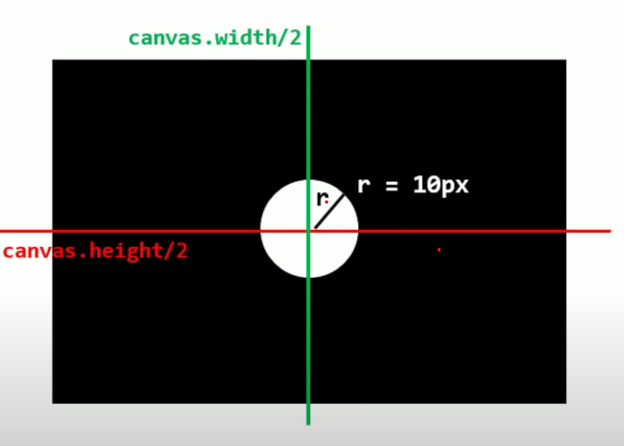
Creating Ball Object
// Ball object
const ball = {
x : canvas.width/2,
y : canvas.height/2,
radius : 10,
velocityX : 5,
velocityY : 5,
speed : 7,
color : "WHITE"
}
// Creating a drawCircle fnc
function drawCircle(ball.x, ball.y, ball.r,
ball.color);

Slide 10
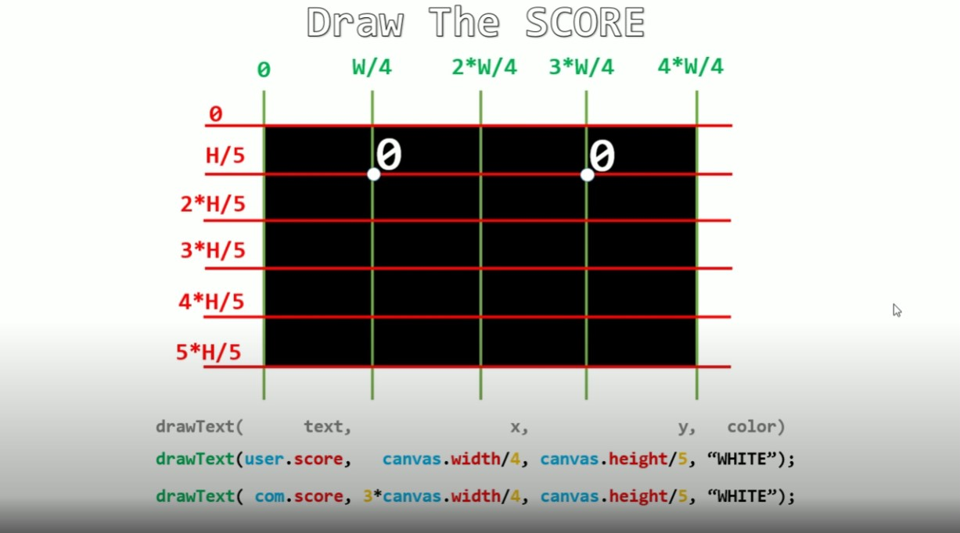
Creating Score Functions

Slide 11
Render The Game
function render(){
// clear the canvas
drawRect(0, 0, canvas.width, canvas.height, "Black");
// draw the user score to the left of net
drawText(user.score,canvas.width/4,canvas.height/5);
// draw the COM score to the right of net
drawText(com.score,3*canvas.width/4,canvas.height/5);
// draw the net in middle
drawNet();
// draw the user's paddle
drawRect(user.x, user.y, user.width, user.height, user.color);
// draw the COM's paddle
drawRect(com.x, com.y, com.width, com.height, com.color);
// draw the ball
drawArc(ball.x, ball.y, ball.radius, ball.color);
}

Slide 12
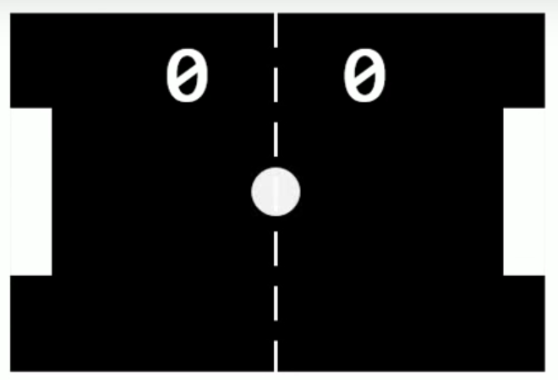
Continue…
function game(){
update(); //function to do main logic of game like movements,collison detection,update score
render();
// number of frames per second
let framePerSecond = 50;
//call the game function 50 times every 1 Sec(1000 ms)
let loop = setInterval(game,1000/framePerSecond);

Slide 13
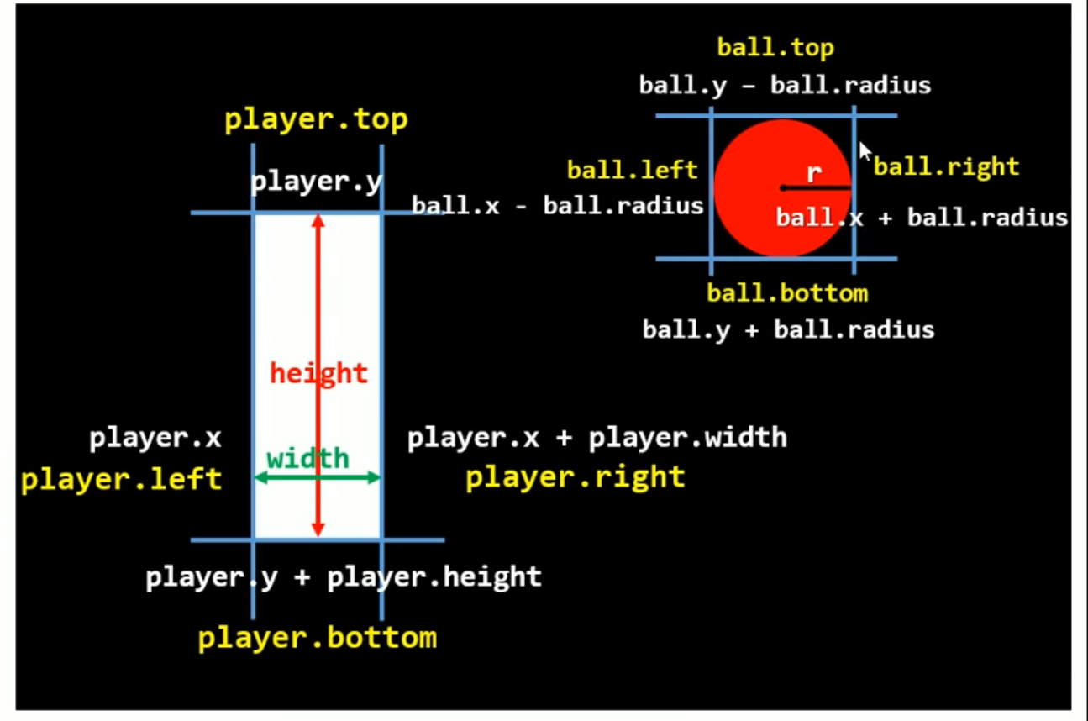
Collision Detection
//player could be both user/com
function collision(b,p){
p.top = p.y;
p.bottom = p.y + p.height;
p.left = p.x;
p.right = p.x + p.width;
b.top = b.y - b.radius;
b.bottom = b.y + b.radius;
b.left = b.x - b.radius;
b.right = b.x + b.radius;

Slide 14
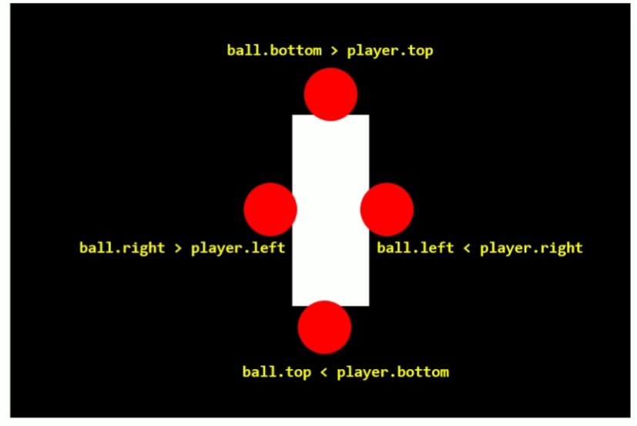
Collision Detection
//condition for contact between ball and paddle
return p.left < b.right && p.top < b.bottom && p.right > b.left && p.bottom > b.top;
}

Slide 15
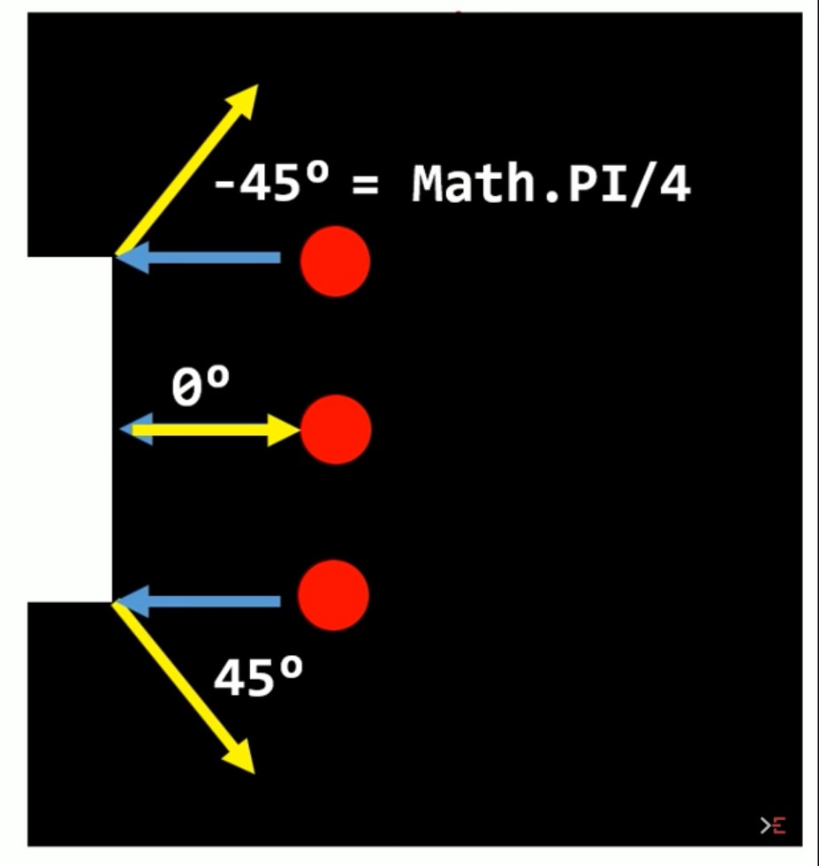
Collision Detection
//check if the paddle hit the user or the com paddle
let player = (ball.x + ball.radius < canvas.width/2) ? user : com;
// if the ball hits a paddle
if(collision(ball,player)){
// we check where the ball hits the paddle
let collidePoint = (ball.y - (player.y + player.height/2));
// normalize the value of collidePoint, we need to get numbers between -1 and 1.
// -player.height/2 < collide Point < player.height/2
collidePoint = collidePoint / (player.height/2);

Slide 16
When ball hits the paddle
/*** when the ball hits the top of a paddle we want the ball, to take a -45degees angle
when the ball hits the center of the paddle we want the ball to take a 0degrees angle
when the ball hits the bottom of the paddle we want the ball to take a 45degrees
Math.PI/4 = 45degrees ***/
let angleRad = (Math.PI/4) * collidePoint;
// change the X and Y velocity direction
let direction = (ball.x + ball.radius < canvas.width/2) ? 1 : -1;
ball.velocityX = direction * ball.speed * Math.cos(angleRad);
ball.velocityY = ball.speed * Math.sin(angleRad);
// speed up the ball everytime a paddle hits it.
ball.speed += 0.1;
}
}

Slide 17
Update Score
// update function, the function that does all calculations
function update(){
// change the score of players,
// If the ball goes to the left i.e "ball.x<0" computer win, else if i.e "ball.x>canvas.width" the user win
//Condition when its Com win
if( ball.x - ball.radius < 0 ){
com.score++;
comScore.play();
resetBall();
}
//Condition when its user win
else if( ball.x + ball.radius > canvas.width){
user.score++;
userScore.play();
resetBall();
}

Slide 18
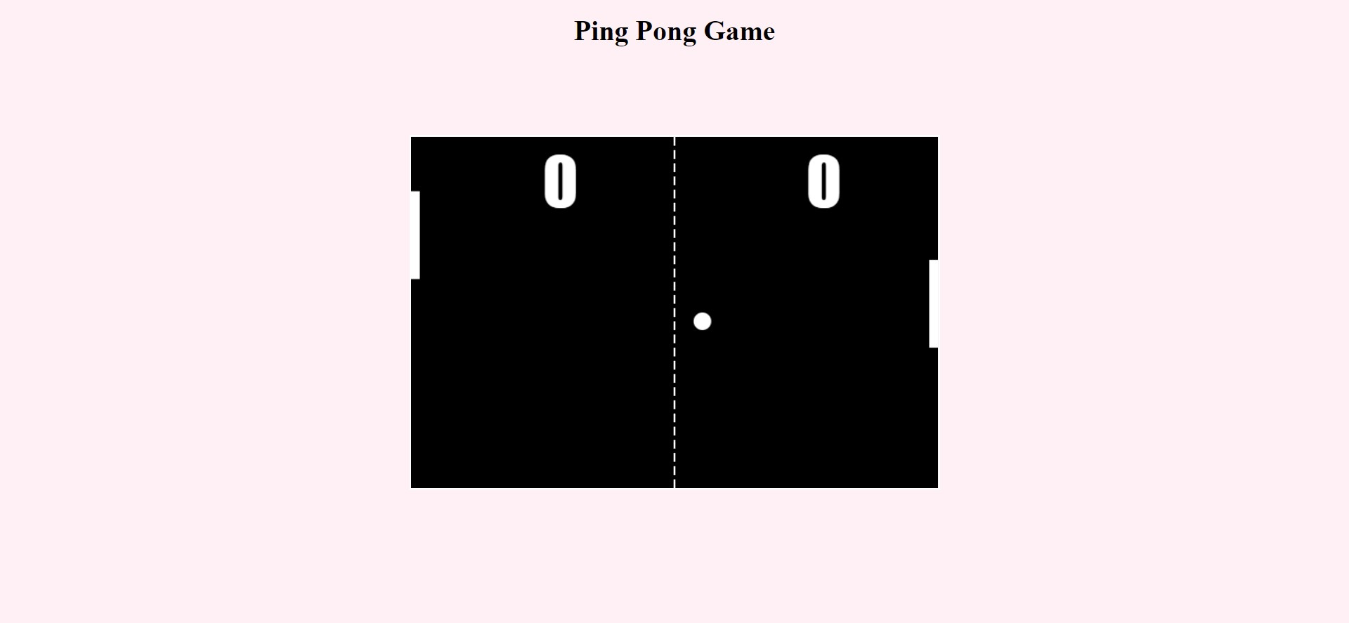
Resulted Game

Slide 19
Thank you !

